Slide 1
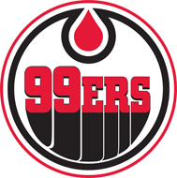
BRANTFORD MINOR HOCKEY NetPlay Goaltender Training Model Version 1.0 October 15th, 2015

Slide 2
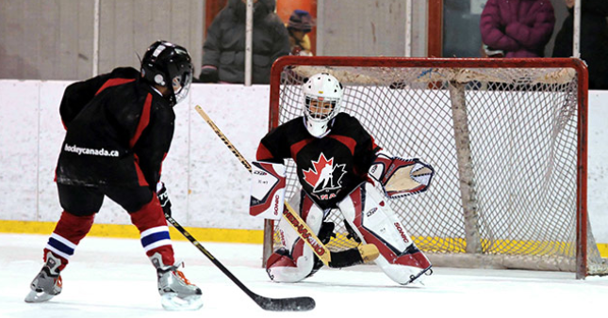
BRANTFORD MINOR HOCKEY NetPlay Goalie Development Model

Slide 3
BRANTFORD MINOR HOCKEY NetPlay Goalie Development Model
The Hockey Canada Goaltender Development
Pyramid was created to provide the coach with
a comprehensive guideline to help develop a
seasonal plan. The natural progression starting
at the base of the triangle emphasizes the
development of fundamental skills.
Fundamental skills are the foundation of each
goalkeeper’s success.
As you climb the pyramid, a greater emphasis
is placed on position-specific skill development; slowly, and progressively, building the core group of skills which will be the foundation of success for years to come.
Once a goalie has developed the skills of
skating and movement, positional play can be
established. Understanding basic positioning
means the goalie is ready to begin their puck stopping endeavors. Moving up the pyramid, the developing goalkeeper performs drills that will develop controlled save movement along with post save responses (i.e. rebound control and recovery).
It is during this phase that the bulk of the fundamental skill set will be established and game tactics can be pursued. Since a tactic is, by definition, a collection of technical skills, it is imperative that this
fundamental set is built first. At the advanced level, tactics form a greater proportion of the development emphasis. But, even at this level, time must be spent maintaining and honing, the goalies’ fundamentals. These refined skills will help push the more advanced approaches to an even higher level. Advanced positioning is at the peak of the pyramid. It rounds out the goalie’s overall approach. It should be noted that the goalie determines the overall style or approach. This notion is vital. Each goaltender is unique and brings a distinct set of personal characteristics to the table. While there are fundamentals that are consistent with any approach, the coach must show some flexibility in allowing a goalie to build a unique style – one that exploits
strengths and mitigates weaknesses. As the age
and experience of the goalie matures, each skill
group can be applied in a more complex fashion.

Slide 4
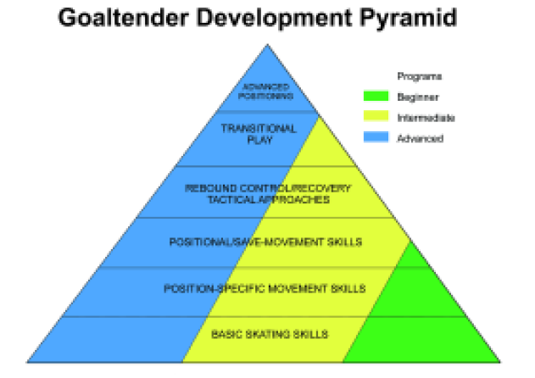
BRANTFORD MINOR HOCKEY NetPlay Goalie Development Model

Slide 5
BRANTFORD MINOR HOCKEY NetPlay Goalie Development Model
You will notice that basic skating sits at the base of the pyramid. The reason for this is simple. Virtually, all goaltender-specific development requires outstanding edge control. For the purpose of this module, basic
skating will be set aside due to the comprehensive analysis done in the associated modules.
The age and skill level of the club’s goaltenders defines their seasonal plan. The Skills Development Programs are based on progressive steps and follow the appropriate allocation of time illustrated in the pyramid. These time allocations relate to goaltender specific time and not to overall practice time.
The goalie plays a crucial role in the broader practice plan and, therefore, there are two categories of development; that which occurs during the broader practice (self development) and that which occurs in a structured, goaltender-specific manner (directed
development). When allocating time, we are referring only to the “directed” development time.
The Beginner Program recommends development be built on 75% movement and positional skills 20% on save movement and related issues and 5% on tactics.
.
The Intermediate Program recommends 50% movement and positional skills, 20% on save movement and related issues and 30% on tactics and transition The Advanced Program recommends 35% movement and positional skills, 10% on post save consequences, 40% on tactics and transition and 15% on advanced positioning.
Hockey Canada believes a coach must emphasize fundamental skill development during practices. It is the responsibility of each coach to teach these fundamental skills to each player.
Hockey Canada also believes that each goaltender, due to the uniqueness of the position, must challenge themselves within the broader practice. The majority of amateur clubs do not have a goaltending coach on staff. Therefore, the goalkeepers and the coaches
must forge a joint development partnership. The coach can provide a strong development environment and allocate a portion of time to goaltender-specific development. The goaltender should carry a strong focus on fundamentals throughout the entire practice,
especially when not receiving specialized
attention.

Slide 6
A save is made up of three main components:
• Preparation
• Save Movement
• Post-Save Consequence
Each of these three elements should be considered when developing a practice plan. Of the three, preparation is the most important. Preparation includes initial positioning, ice awareness, positional
adjustments to optimize position and the final setting of the goaltender’s body. It is this combination of skills that paves the way for save success and performance
consistency. To ensure that the goaltender has time to
prepare, drills must be gapped properly. As a general rule, and due to the importance of preparation, rapid-fire drills serve little purpose.
Drills which only emphasize the save
movement aspect of the save have little to no
game relevance.
During warm-up drills, the gap between shots can be reduced because the objective is to warm the goalie up and allow the goaltender to feel the puck.
Talk to the goaltender about the three
aspects of a save. There are often many drills
in which the goaltender has plenty of time to
prepare, make the save and, then, respond
appropriately to the consequence. It is the
coach’s job to create a positive development
environment but it is the goaltender’s job to
apply an appropriate work ethic which
considers each of these three save phases.
Drills can often be designed or adjusted by
having the shooting player start the following
sequence. This ensures that a proper gap is
established.
In time, and as the goaltender develops,
drills should be as dynamic and game realistic
as possible. In the early years,
emphasis should be placed on preparation
and the initial save. As the goalie progresses,
force a greater amount of accountability to
rebounds by designing drills which
incorporate a potential rebound.
BRANTFORD MINOR HOCKEY NetPlay Goalie Development Model

Slide 7
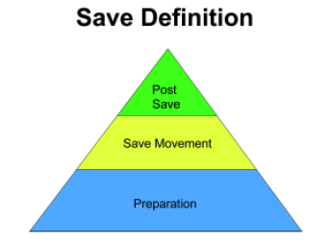
BRANTFORD MINOR HOCKEY NetPlay Goalie Development Model

Slide 8
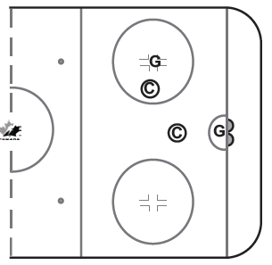
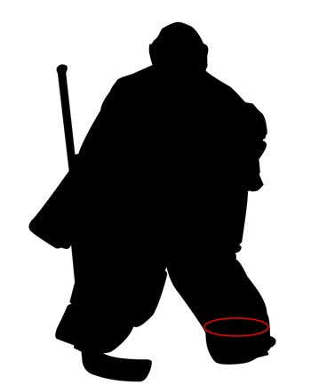
BRANTFORD MINOR HOCKEY NetPlay Goalie Development Model
Goaltending – Basic Stance (Beginner)
Start in athletic stance, (eyes on the puck, shoulders square,
back slightly arched and body slightly leaning forward, glove
and blocker in front of the body with glove over top of the
toe of the stick, hips square, knees are bent, skates are at a
distance of approximately 1 and 1/3 shoulder widths apart,
stick covers 5 hole and is positioned 1.5 blade lengths in front
of the skates.)
Click for video…

Slide 9
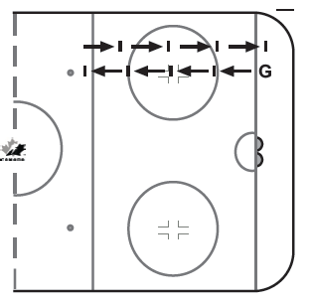
BRANTFORD MINOR HOCKEY NetPlay Goalie Development Model
Goaltending – Shuffle
Start in athletic stance, (eyes on the puck, shoulders square,
back slightly arched and body slightly leaning forward, glove
and blocker in front of the body with glove over top of the
toe of the stick, hips square, knees are bent, skates are at a
distance of approximately 1 and 1/3 shoulder widths apart,
stick covers 5 hole and is positioned 1.5 blade lengths in front
of the skates.
Skill
• Push skate gains traction with the front 1/3 of the blade.
• Knees are bent, leg is extended straight and skate pointed
to generate lateral movement
• Lead/Glide skate glides along ice with toes always facing the
puck.
• Stick protects the 5-hole and is prepared to direct pucks
away at all times.
Key Points
• Push distance -1 body width per shuffle
• No bobbing / stick on ice / quiet upper body
Drill:
Push– recover – push – recover – small steps
When it’s used.
Used for short distance and re-positioning to maintain
squareness to the shot
Click for video…

Slide 10
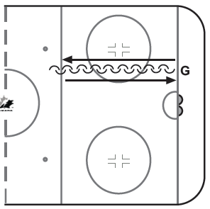
BRANTFORD MINOR HOCKEY NetPlay Goalie Development Model
Goaltending – C-Cuts Forward and
Backward Skating
Start in athletic stance, (eyes on the puck, shoulders square,
back slightly arched and body slightly leaning forward, glove
and blocker in front of the body with glove over top of the
toe of the stick, hips square, knees are bent, skates are at a
distance of approximately 1 and 1/3 shoulder widths apart,
stick covers 5 hole and is positioned 1.5 blade lengths in front
of the skates.)
Skill
• Skate blades stay on ice (using inside edges to generate
speed and power) – Alternate with hard c-cut with each leg
• For Backward C-Cuts: Balance and weight distribution on
balls of feet ( front 1/3 evenly distributed)
• For Forward C-Cuts: Balance and weight distribution on rear
1/3 of the skate and evenly distributed)
• Head up, glove out and open waist level, blocker facing
forward, Glove open with palm to the puck.
When it’s used.
• Often used for forward and backward movement and
repositioning gaining better angle and depth
Click for video…

Slide 11
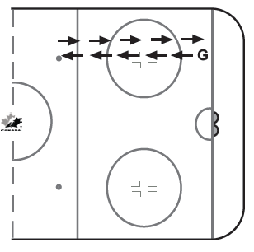
BRANTFORD MINOR HOCKEY NetPlay Goalie Development Model
Goaltending – T-Push
Start in athletic stance, (eyes on the puck, shoulders square,
back slightly arched and body slightly leaning forward, glove
and blocker in front of the body with glove over top of the
toe of the stick, hips square, knees are bent, skates are at a
distance of approximately 1 and 1/3 shoulder widths apart,
stick covers 5 hole and is positioned 1.5 blade lengths in front
of the skates.)
Skill
• Point glide skate in direction to go with heal of the glide
foot facing the load / load/push skate.
• Load/push skate gains ice traction and pushes until load leg
is straight and the ankle is extended.
• Stick is on the ice and positioned to protect 5 hole (both
ways)
Key Points
Knees bent is for stronger push and distance
Maintain stance throughout the movement phase and be prepared
to stop a shot throughout process
Drill:
Stance – T-Push – stop with glide skate –Stance (set) – (push
with one leg / stop with other) repeat Pushing with one skate,
gliding on the other
When it’s used.
Used for traveling longer distance and speed
Click for video…

Slide 12
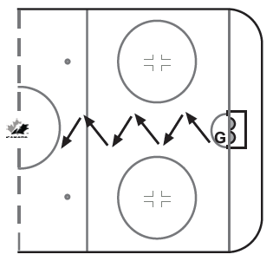
BRANTFORD MINOR HOCKEY NetPlay Goalie Development Model
Goaltending – Diagonal T – Push
Start in athletic stance, (eyes on the puck, shoulders square,
back slightly arched and body slightly leaning forward, glove
and blocker in front of the body with glove over top of the
toe of the stick, hips square, knees are bent, skates are at a
distance of approximately 1 and 1/3 shoulder widths apart,
stick covers 5 hole and is positioned 1.5 blade lengths in front
of the skates.)
Skill
• Locate the puck
• Lead with your eyes and stick to the puck
• Rotate the shoulders to square up to the puck
• Activate the loading of the push skate (front 1/3 of the skate
gains traction in the ice)
• Glide skate toe points to the where to go
• Push leg is thrust into a straightened positioned with ankle
extended
• Push leg always maintains contact with the ice for quick
adjustments.
• Glide leg stops into position using the front 1/3 of the skate
• Push leg is repositioned in the athletic stance in set position
• Stick is on the ice and protecting the 5 hole at all times
• Eyes are always locked on the “puck”
Key Points
• Lead with your eyes and stick at all times
• Emphasize a solid stop after each movement
• Do NOT rise out of athletic stance position throughout the
drill.
Click for video…
Drill:
• Goalie starts on the goal line and t-pushes diagonally from side to side, until they reach the blue line.
• Goalie then turns and goes backwards doing the same thing.
• The goaltender should not get off track or off angle.
• Should be able to finish where they start.

